Slide 1
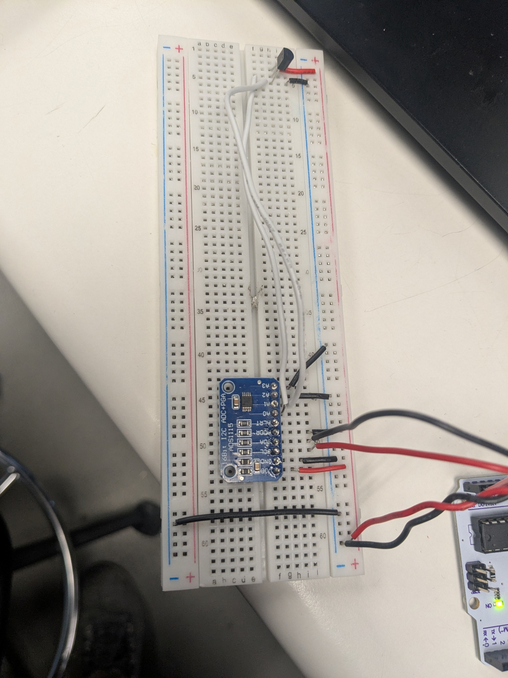
Lab 16 Findings
Joseph Abroquah
Data Collected: 10/22/2025
Goal: compare analog signal measurements from a temperature sensor using a single ended and differential pair measurement
POR:
  Temperature sensor serves as a voltage source.
  Power the board and the sensor with 5V from the Arduino.
  Add noise to the ground path via a function generator.
  Observe the difference between a differential and a common signal measurement.

Slide 2
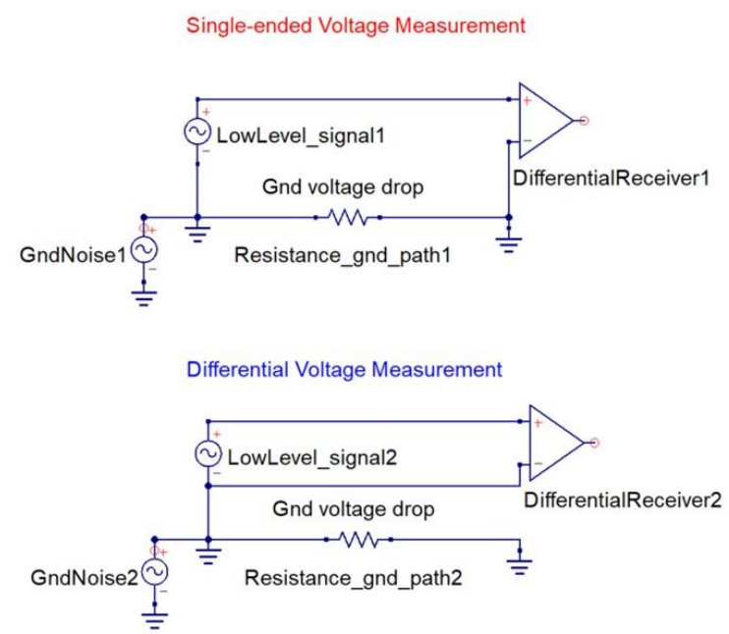
Results
The configuration for the single-ended measurement shows that the two grounds are connected through a long trace that has a small resistance. When current flows, a voltage drop appears between the two grounds. This noise is taken up into the measurement. So, this configuration is sensitive to noise.
On the hand, the differential configuration is immune to common-mode ground noise because it has one local ground reference, so ground noise from the trace is not detected.

Slide 3
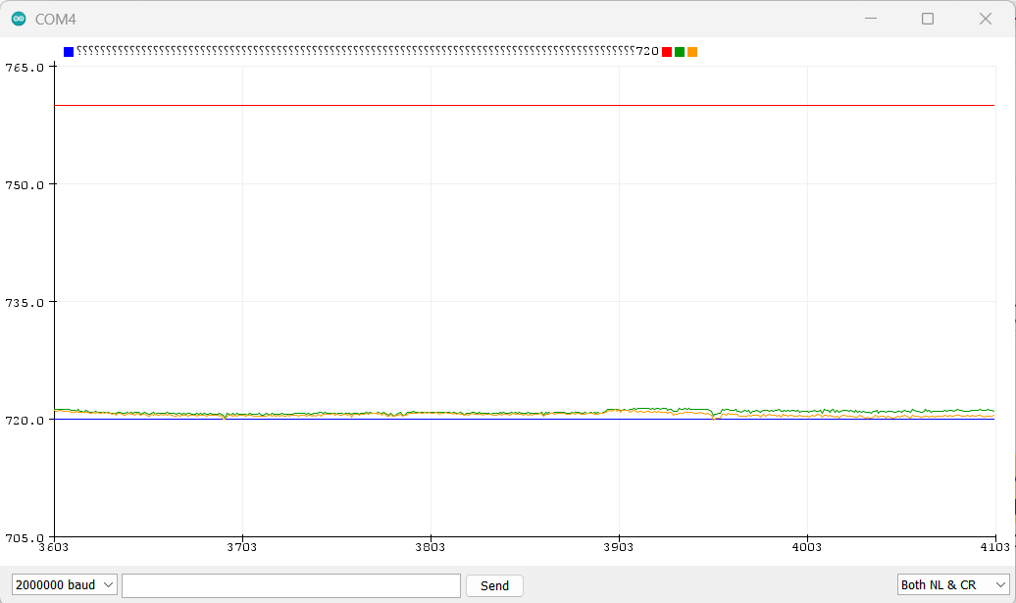
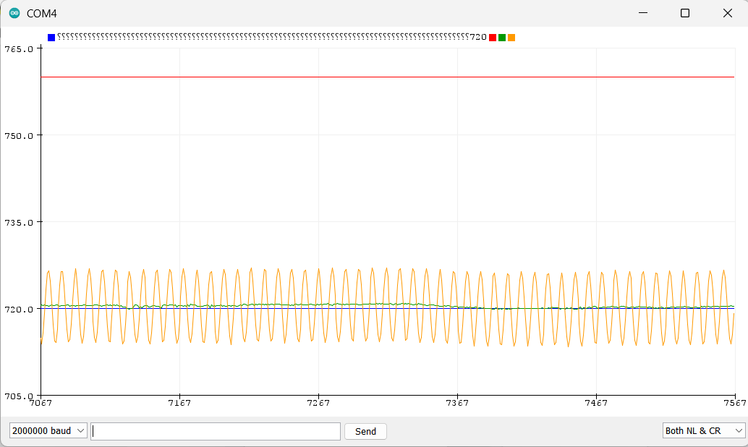
Results
Without noise added to ground, single-ended and differential readings were nearly identical.
When a sinusoidal noise function was injected into the ground return path, there differential channel showed no measurable noise while single-ended channel showed around 8mV p-p noise.
Key Findings
Single-ended measurement will be more sensitive to noise on the ground line while the differential measurement will not be sensitive to the noise.
Single-ended measurement is not reliable for noise systems.
Differential measurement takes more space as it requires more wiring.

